Slide 1

Introduction to Metadata
By : Zena Ghidey

Slide 2
Digital Object
Is made up of 2 components:
The digital asset or bitstream:
image, sound, book, audio, data set, etc.
It’s affiliated metadata (“data about data”)

Slide 3
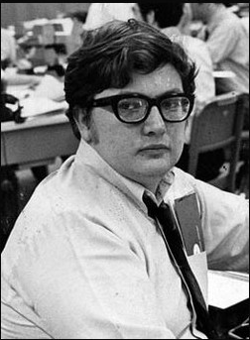
Why Does Metadata Matter?
“Doing research on the Web is like using a library assembled piecemeal by pack rats and vandalized nightly. ” (Roger Ebert)
How do you find these materials?
  Audio
  Images
  Video
  Text

Slide 4

Digital library system objectives
Metadata must support:
  Discovery
  Navigation
  Presentation
  Access control
  Administration & Management
  Preservation
Notes:
The objectives listed should sound familiar to librarians.
This is a functional view of metadata. These functions can be associated with types of metadata (discussed in the next session):
Discovery: descriptive metadata
Navigation (of an object and its components): structural metadata
Access control: rights metadata
Other objectives that a digital library might have, besides those listed? Someone will probably come up with some. Here are some possibilities, if no one thinks of any others.
Interoperability
Certification (of document authenticity)
Status (or perhaps that’s under admin/management metadata, depending on how that’s defined)
Version control
Could think about different contexts: libraries within archives, museums, schools, businesses. And whether different contexts might generate different objectives.

Slide 5
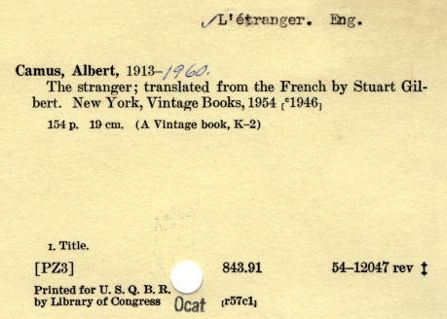
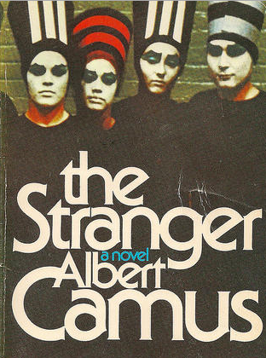
What is Metadata?
Is it fancy word for “cataloging”?
In the standard library world, catalog records are metadata, as they contain information about the library's collection of "data", (i.e. the books, journals, and electronic resources) that make up its collections.

Slide 6
What is Metadata?
Metadata is the data that facilitates management, description, and preservation of our digital objects or collections of digital objects.
Metadata creation is typically governed by a body of standards, best practices, schema that when used correctly, ensure effective management, description and preservation of digital objects.

Slide 7
What is Metadata?
One more definition ☺
“Metadata is structured information that describes, explains, locates, or otherwise makes it easier to retrieve, use, or manage an information resource.”

Slide 8

Type of Metadata
Descriptive: facilitating resource discovery and identification
Administrative: supporting resource management within a collection
Structural: binding together the components of complex information objects
Technical: Related to how the system works
Use: Related to the level and type of use
Preservation: related to the preservation/longevity

Slide 9
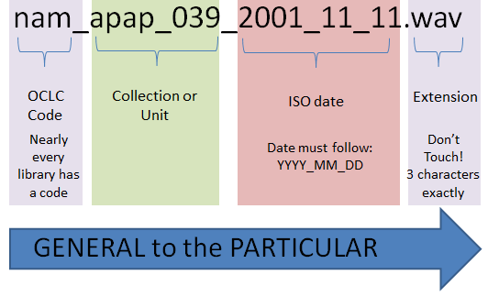
Filenaming
One of the first metadata events that you do
We’ve already talked about best practices
Also, restrictions placed by the operating systems of what’s allowed in the filename

Slide 10
Metadata storage
Database
Embedded in the file
Flat text file
XML file
XML Database
JSON
Linked Data (future)

Slide 11
Metadata Standards
Communities have specific information needs
Interoperability requires standards in order for one community to “speak” to another
In moving from dispersed digital collections to interoperable digital libraries, the most important activity we need to focus on is standards… most important is the wide variety of metadata standards [including] descriptive metadata… administrative metadata…, structural metadata, and terms and conditions metadata…” Howard Besser

Slide 12
Metadata Element Sets/Standards
MARC21: used in libraries
Dublin Core (DC): used across disciplines (more later)
EAD: (Encoded Archival Description) archives, describes physical collections and some digital
MODS (Metadata Object Description Schema)
VRA Core (Visual Resources Association)
METS (Metadata Encoding and Transmission Standard )
Notes:
If data is in XML, it’s usually easy to detect the metadata scheme: look at the “root” element, the element at the top of the file that holds all other element inside of it.
Some of these schemes are bound very closely with a particular data exchange format, to the point where they seem inseparable. For example, METS is expressed in XML; EAD is expressed in SGML or XML; But what we are looking at right here are the data element definitions, which at least in theory can be separated from an exchange syntax. This distinction is much easier to make with DC and VRA, which can be expressed, or encoded, in different file formats.

Slide 13
Dublin Core
Version 1.1
Vocabulary of 15 field element set for use in digital resource description
"Dublin" is due to its origin at a 1995 invitational workshop in Dublin, Ohio—suburb of Columbus
OCLC based there, and oversees the standard

Slide 14
How and why did the Dublin Core come to be in 1995?
Dramatic increase in the number of document-like resources on the net
Slow improvement in indexing services made resources hard to discover
Belief that descriptive metadata would improve discovery
Perceived need for a descriptive standard that was simple to implement (by non-professionals)
to create a digital "library card catalog" for the Web.

Slide 15
Dublin Core 15 Element Set
Creator | Title | Subject
Contributor | Date | Description
Publisher | Type | Format
Coverage | Rights | Relation
Source | Language | Identifier

Slide 16
Interoperability
is the ability of a system or a product to work with other systems or products without special effort on the part of the user.
to be interoperable, one should actively be engaged in the ongoing process of ensuring that the systems, procedures and culture of an organization are managed in such a way as to maximize opportunities for exchange and re-use of information, whether internally or externally. (Paul Miller)
Metadata standards allow for interoperability

Slide 17
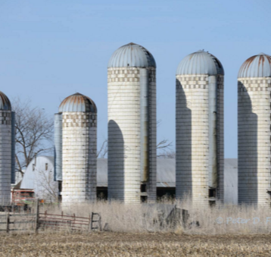
Interoperability
We seek to avoid silos of information
  Duplicative metadata creation
  Reduced efficiency
  Greater chance for inconsistent description across systems
Sometimes a necessary evil…

Slide 18
What are Examples of Silos?
Integrated Library System (ILS)
Institutional Repository
Dspace, Fedora, EPrints
Various journal vendors (JSTOR, EBSCOetc.)
Digital Asset Management Systems
Luna or Content DM
Learning Management System
Blackboard, Sakai
Content Management System
Drupal, Red Dot, Wordpress

Slide 19
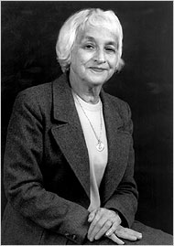
The Rise of MARC
MARC (MAchine Readable Cataloging)
MARC became a national standard in 1971
First time technology was used to catalog
The term “mark-up” comes from “marking up a manuscript”. It’s information about the information.
Not until the advent of SGML/XML was there a clear distinction between markup and the information it was tagging or marking up
Henriette Avram

Slide 20
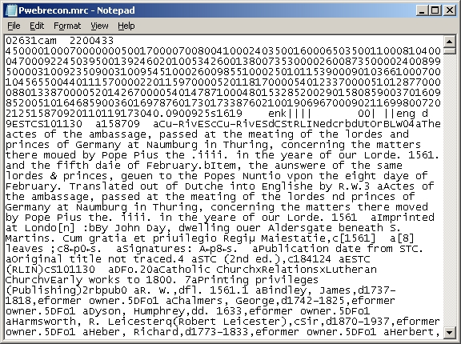
MARC From a Different Era

Slide 21
MODS (Metadata Object Description Schema)
MODS was developed as a descriptive metadata scheme oriented toward digital objects, and drawing from the MARC 21 Format.
Uses XML
A derivative of MARC
MODS does not assume the use of any specific rules for description
Element set is particularly applicable to digital resources
Will probably supplant Dublin Core

Slide 22
XML and Metadata
XML is the de-facto standard for metadata descriptions on the Internet <root></root>
Interoperability and object exchange requires the use of established standards
Complex digital objects require many more forms of metadata than analog for their management and use

Slide 23
XML
What is XML?
EXtensible Markup Language. XML is a set of rules for defining markup languages and describing data.
Why XML?
XML is a standard means of delivering structured data via Web applications.
XML is extensible—both a blessing and a burden
Authors can define their own tags and attributes, e.g. CML Chemical markup language
A well-formed XML file conforms to a set of very strict rules that govern XML. If a file doesn't conform to those rules, XML stops working

Slide 24
MARC versus XML
In MARC: 245 04 $a The Big heat
In XML: <title>Big heat</title>
<name>value</name>
MARC XML https://www.loc.gov/standards/marcxml/Sandburg/sandburg.xml
XML has become the de-facto encoding standard for representing metadata descriptions of digital resources

Slide 25
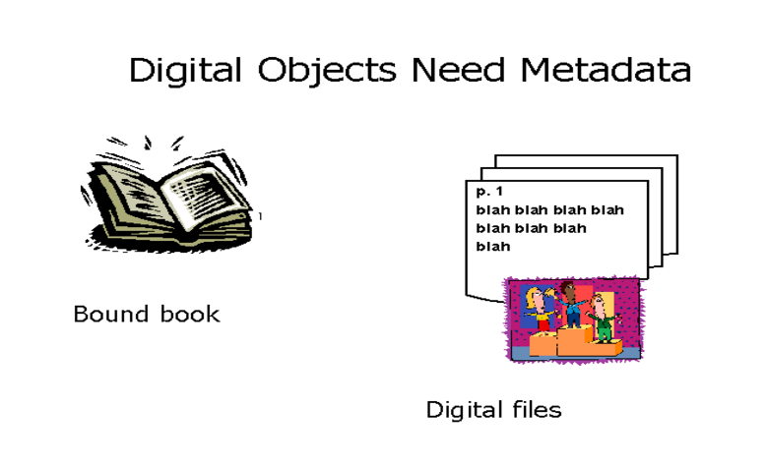
What about Complex/Hierarchical Objects (Books etc.)?

Slide 26

METS
METS is an XML Schema designed for the purpose of creating XML documents that express the hierarchical structure of digital library objects, the names and locations of the files that comprise those objects, and the associated metadata.
Puts a virtual wrapper around digital files that need to be held together

Slide 27
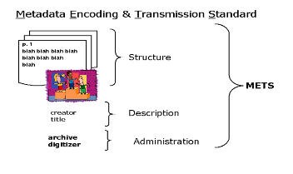
METS Hierarchy and Complexity

Slide 28
Where Metadata is Stored
Embedded in the resource itself
  EXIF, IPTC, XMP or BEXT chunk for audio
Spreadsheet
Relational Database
Flat files
  Comma Separated Values(.csv)
  Space or Tab Delimited (.txt)
XML
  Flat file
  XML database

Slide 29
Metadata Tools
Spreadsheets (Excel)
Standalone
Database (Access)
Standalone
Web form
XML
Digital Library Content Management System

Slide 30
Metadata Management Tools
Open Refine (formerly Google Refine) is a powerful tool for working with messy data: cleaning it; transforming it from one format into another; and extending it with web services and external data.
OpenWMS: The OpenWMS is a platform-independent, open source, web-accessible system that can be used as a standalone application or integrated with other repository architectures by a wide range of organizations. It provides a complete metadata creation system for analog and digital materials, with services to ingest objects and metadata into a Fedora repository and to export these objects and metadata, individually and in bulk in METS/XML Wrapper

Slide 31
Rules for Description
Vocabularies
AACR
RDA
Genre
AAT (Art and Architecture Thesaurus)
Rules for Archival Description
RAD (Rules of Archival Description)
DACS (Describing Archives Content Standard)

